Slide 1
THE IMPLICATIONS / APPLICATION / OPPORTUNITIES OF PRIPPs / KIDS BILL CASEY, DIRECTOR OF FINANCIAL ADVISOR SERVICES, CONEXIM 28TH MARCH 2018

Slide 2
Regulatory issues topical at turn of year
MiFID II
Commission – Restricted ? Banned?
Independent/non Independent

Slide 3
Under the Radar!
PRIIPs
Packaged Retail and Insurance-Based Investment Products (PRIIPs)
A PRIIPs is a packaged retail and insurance-based investment product that might be subject to investment risks for retail investors.

Slide 4
Under the PRIIPs Legislation product providers are required to produce
KIDs (“Key Information Documents”) for Investment Products
What is a KID?
A Key Information Document (“KID”) is an information sheet consisting of at most three A4 pages.
It provides the consumer with information on the main features of the respective product.
Focus is on the risks, reward profile and costs associated with the product.

Slide 5
One of the consequences of PRIIPs to Financial Advisors in Ireland
It has forced the Life companies to provide transparency on fund costs in certain instances
The purpose of today is to show where the details can be found and how to use them using information currently available from the life companies

Slide 6
As of January this year all Life companies have had to made KID’s available for all investment options for non pension investments
However issues remain:
Not uniform
Complex
Pension’s / ARF’s

Slide 7
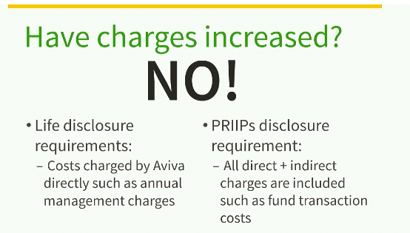
Most frequent initial query from Advisors…

Slide 8
We have examined PRIIPS information available from four of the main life companies
Two main findings
1. Annual fund costs higher than we thought
2. Commission, makes clear who pays

Slide 9
How to find Zurich PRIIPS info
www.Zurich.ie
Brokers
Zurich Life Broker Centre
PRIIPs Key Information document
Lifesave Investment Bond
‘Key Info Doc’ ‘Fund specific info doc’

Slide 10
Zurich

Slide 11
Zurich
Dimensional - World Allocation 60/40 | Entry Cost | Annual Custody | Ongoing Charge | Transaction costs | Annual Trail | Total ongoing cost pa
Life Co Investment Bond* | Various (1% life levy + allocation / commission) | n/a | 2.09% | 0.02% | (0.50% inc in Ongoing charge) | 2.11%
Conexim Personal Account | 0% | 0.30% | 0.47% | 0.02% | 0.50% | 1.29%
*Based on 100% allocation and AMC of 1.5%

Slide 12
Zurich
Queries
If you have any questions on our KID/SIDs and on comparing them with competitor products, please contact your Zurich Broker Consultant.

Slide 13
New Ireland
Brokers Ireland Compliance Update 6.3.18
Costs/Charges – Some product providers have adopted the approach of using the worst pricing scenario for the basis of the KID. This means that when you provide the KID, the cost outlined are not accurate for the client and overstate the possible costs/charges for the client. This is causing confusion for both the Broker and clients at the point of sale.

Slide 14
New Ireland
New Ireland.ie
Fund Centre
Key Information Documents (KIDs)
Single Premium
Smart fund

Slide 15
100% Allocation 1.5% AMC (1% AMC, .5% trail)
Company | Fund | Initial allocation | Annual custody | Entry/Exit costs | Ongoing Charge | Transaction | Annual Trail | Total ongoing cost pa
Zurich | DFA 60/40 | 100% | n/a | 0.15% | 2.09% | 0.02% | (.5% inc in Ongoing charge) | 2.26%
Zurich | Prisma 4 | 100% | n/a | 0.21% | 1.72% | 0.13% | (.5% inc in Ongoing charge) | 2.06%
New Ireland | iFunds 4 | 100% | n/a | 0.15% | 2.02% | 0.14% | (.5% inc in Ongoing charge) | 2.31%
New Ireland | Prime 4 | 100% | n/a | 0.15% | 1.69% | 0.04% | (.5% inc in Ongoing charge) | 1.88%
Conexim | DFA 60/40 | 100% | 0.30% | 0.00% | 0.47% | 0.02% | 0.50% | 1.29%
Conexim | Morningstar Moderate | 100% | 0.30% | 0.00% | 0.60% | 0.13% | 0.50% | 1.53%
Company | Fund | Assumed annual gross return | Less annual ongoing cost | Net Annual Return | €100,000 after year 1 | €100,000 after year 5 | €100,000 after year 10
Zurich | DFA 60/40 | 6% | 2.26% | 3.74% | €103,740 | €120,152 | €144,365
Zurich | Prisma 4 | 6% | 2.06% | 3.94% | €103,940 | €121,314 | €147,172
New Ireland | iFunds 4 | 6% | 2.31% | 3.69% | €103,690 | €119,862 | €143,670
New Ireland | Prime 4 | 6% | 1.88% | 4.12% | €104,120 | €122,368 | €149,741
Conexim | DFA 60/40 | 6% | 1.29% | 4.71% | €104,710 | €125,875 | €158,446
Conexim | Morningstar Moderate | 6% | 1.53% | 4.47% | €104,470 | €124,439 | €154,851

Slide 16
Aviva
Aviva.ie/broker
PRIIPs Key Information (KID) tool (Bottom right graphic)
FAQ
About key information document
What level of commission have Aviva chosen to include in performance and cost scenarios in the KID?
How is the most representative level of commission determined?
What are the most represented commission rates for Aviva products?

Slide 17
Aviva

Slide 18
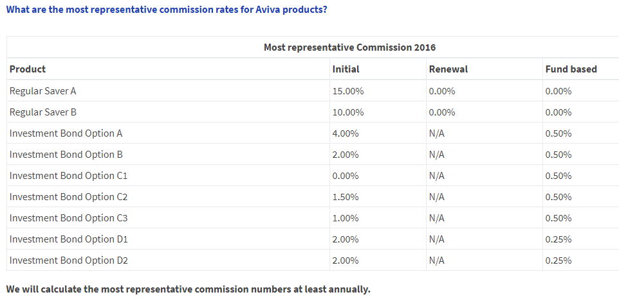
Aviva

Slide 19
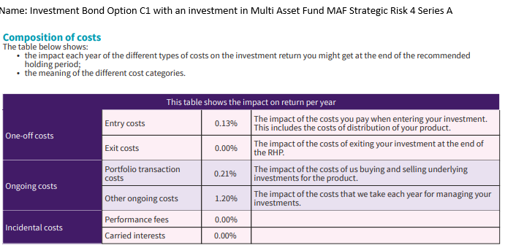
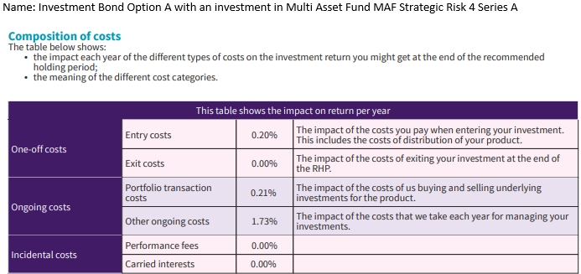
Aviva

Slide 20
Irish Life
Irish Life have produced a clarification sheet which is available pre-sale which indicates the correct levels of cost dependant on the terms that the Financial Broker has agreed with their client. Brokers can access the document via their Bline site when they log in and go to the MyBiz page, PRIIPs section – https://www.bline.ie/mybliz/Priips
>bline
>Mybiz
>PRIIPs
Single Premium Signature Bond
MAPS 4 (on the dropdown menu)

Slide 21
Irish Life
Standard KID document for Maps 4

Slide 22
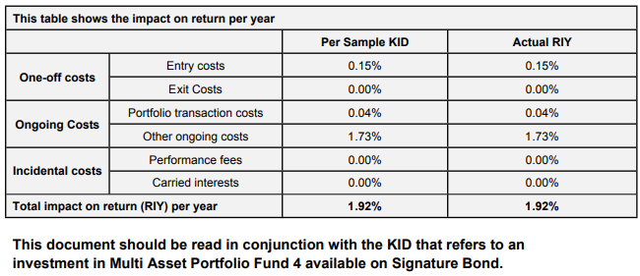
Irish Life

Slide 23
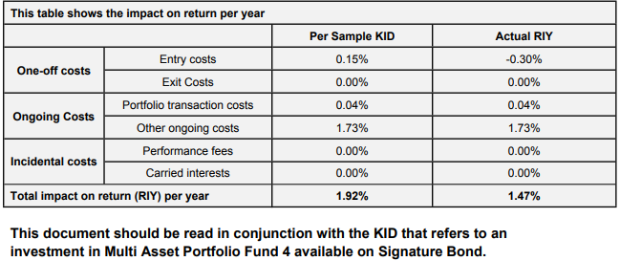
Irish Life

Slide 24
Initial Commission vs Initial fee
 | Initial Allocation | Initial to Adviser | Net Invested for client | €100,000 INVESTMENT | Estimated Gross annual return | less cost drag | Net annual Return | After Year 1 | After Year 5 | After Year 10
Life Co | 103% | 3% | 100% | €100,000 | 6% | 1.92% | 4.08% | €104,080 | €122,134 | €149,167
Platform | 100% | 3% | 97% | €97,000 | 6% | 1.29% | 4.71% | €101,566 | €122,099 | €153,693
Platform | 100% | 1% | 99% | €99,000 | 6% | 1.29% | 4.71% | €103,662 | €124,616 | €156,861
Platform | 100% | 1% | 99% | €99,000 | 6% | 1.54% | 4.46% | €103,415 | €123,136 | €153,156
 | Initial Allocation | Initial to Adviser | Net Invested for client | €100,000 INVESTMENT | Estimated Gross annual return | less cost drag | Net annual Return | After Year 1 | After Year 5 | After Year 10
Life Co | 104% | 4% | 100% | €100,000 | 6% | 2.14% | 3.86% | €103,860 | €120,848 | €146,044
Platform | 100% | 4% | 96% | €96,000 | 6% | 1.29% | 4.71% | €100,521 | €120,840 | €152,108
Platform | 100% | 1% | 99% | €99,000 | 6% | 1.29% | 4.71% | €103,662 | €124,616 | €156,861
Platform | 100% | 1% | 99% | €99,000 | 6% | 1.54% | 4.46% | €103,415 | €123,136 | €153,156

Slide 25
Cost analysis only one aspect of a Financial Advisor’s services nevertheless an important one
Two choices
1. Embrace and educate
2. Ignore
Consequences to both

Slide 26
Summary
Clarity will enable fair comparison and ultimately benefit both advisor and client
Same costs apply to funds invested in Pensions, currently no requirement for full disclosure on costs
Costs out of the box - won’t be going back in
Test your BC’s

